Slide 1
2016 Southern Union Communication’s Report
Eric Cadiente—BS, RDCS, RVT
Director of Marketing & Public Relations

Slide 2
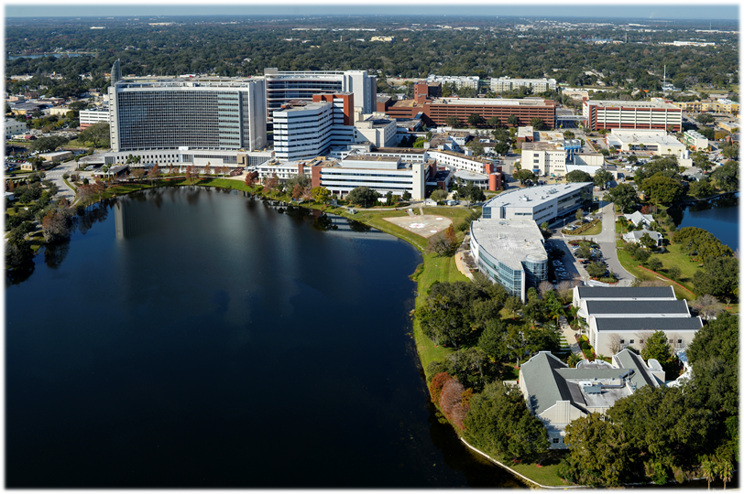
Adventist University of
Health Sciences (ADU)
ADU is a fully accredited health sciences university, committed to reflecting the image of God through education and healing.
Located in Orlando, FL
Part of Florida Hospital & Adventist Health System
Founded in 1992
Accredited
  AAA
  SACS-COC

Slide 3

Undergradte
Graduate
Associate
  Advanced Medical Assistant
  Occupational Therapy Assistant
  Radiography
Bachelors
  Biomedical Sciences
  Conductive Education
  Health Sciences
  Healthcare Administration
  Nuclear Medicine Technology
  Nursing
    RN-BSN (online)
    Traditional
  Radiography
    BS Completion (online)
  Sonography
    Traditional
    BS Completion (online)
Masters
  Healthcare Administration
    Master of Healthcare Administration
    Executive Master of Healthcare Administration (online)
    Master of Healthcare Administration in Strategy & Innovation (online)
      Associate to MHA-SI track
  Nurse Anesthesia (DNAP 2018)
  Occupational Therapy
  Physician Assistant Studies (PA)
Doctorate
  Physical Therapy

Slide 4

Noteworthy Items
Level change III to V
Nurse Anesthesia—DNAP
Honor’s College
Centers of Excellence
  Center for Advanced Ultrasound Education
  Center for Population Health Research
Stetson University
MHA students-rounding with FH chaplains
Mission Motto
  Developing skilled professionals who Live the healing values of Christ.

Slide 5



Slide 6

Digital Advertising
Optimized for mobile
Digital search (Google)
Geo-targeting/fencing
Mobile advertising
Social Media content management

Slide 7






2014-16 Media Overview
2014-16 heavy media buys-focused on brand awareness
  Radio
  Television
  Movie Theaters
  Sponsorships
Branding/Awareness

Slide 8


Public Relations
Meltwater—media services
  Monitoring
  Reach
  Social Media
  Target select journalist, influencers, bloggers
    350,000—new outlets & journalist
    3,000,000—social media outlets and bloggers
  Target distribution of news
  “Quality over quantity” of distribution
PR Newswire

Slide 9



25th Anniversary Celebration

Slide 10
25th Anniversary Videos
http://www.adu.edu/news/video-adu-celebrating-25-years
http://www.adu.edu/news/adu’s-founding-president-david-greenlaw-celebrates-25th-anniversary

